Slide 1
GCE2231 Materials Characterizations
Mst. Esmotara Begum
Lecturer
GCE, RUET

Slide 2
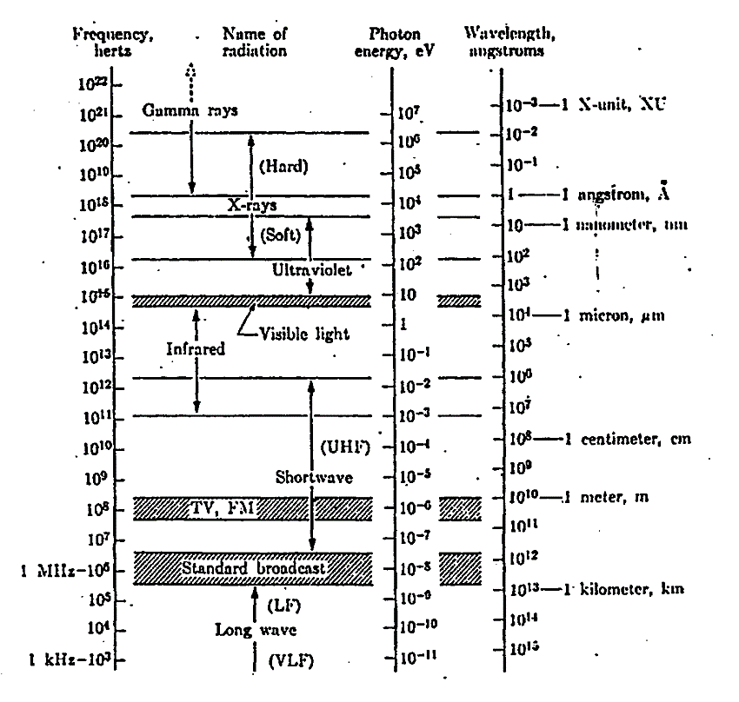
X-Rays
X-rays were discovered in 1895 by the German physicist Röntgen and were so named because their nature was unknown at the time.
Diffraction of X-ray was discovered by W.H. Bragg and W.L. Bragg in 1912

Slide 3
Properties and Generation of X-Rays
X-rays are electromagnetic radiation with very short wavelength (10⁻⁸ -10⁻¹² m)
The energy of the x-ray can be calculated with the equation E = h𝞾 = hc/λ; e.g. the x-ray photon with wavelength 1Å has energy 12.5 keV
X-rays are produced whenever high-speed electrons collide with a metal target.
Unlike ordinary light, these rays were invisible, but they traveled in straight lines and affected photographic film in the same way as light. On the other hand, they were much more penetrating than light and could easily pass through the human body, wood, quite thick pieces of metal, and other “opaque” objects. X-rays are a form of electromagnetic radiation (like light); they are of higher energy, however, and can penetrate the body to form an image on film.

Slide 4
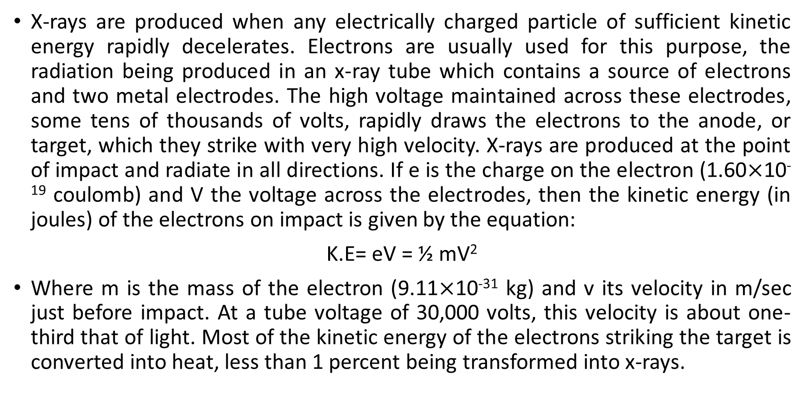
X-rays are produced when any electrically charged particle of sufficient kinetic energy rapidly decelerates. Electrons are usually used for this purpose, the radiation being produced in an x-ray tube which contains a source of electrons and two metal electrodes. The high voltage maintained across these electrodes, some tens of thousands of volts, rapidly draws the electrons to the anode, or target, which they strike with very high velocity. X-rays are produced at the point of impact and radiate in all directions. If e is the charge on the electron (1.60$×$10⁻¹⁹ coulomb) and V the voltage across the electrodes, then the kinetic energy (in joules) of the electrons on impact is given by the equation:
K.E= eV = ½ mV²
Where m is the mass of the electron (9.11$×$10⁻³¹ kg) and v its velocity in m/sec just before impact. At a tube voltage of 30,000 volts, this velocity is about one-third that of light. Most of the kinetic energy of the electrons striking the target is converted into heat, less than 1 percent being transformed into x-rays.

Slide 5
Production of X-rays
X-rays can be generated by an X-ray tube, a vacuum tube that uses a high voltage to accelerate the electrons released by a hot cathode to a high velocity. The high velocity electrons collide with a metal target, the anode, creating the X-rays.
As x-rays are produced whenever high-speed electrons collide with a metal target, any x-ray tube must contain
A source of electrons (hot W filament),
A high accelerating voltage, and
A metal target (Cu, Al, Mo,Mg)
Furthermore, since most of the kinetic energy of the electrons is converted into heat in the target, the latter is almost always watercooled to prevent its melting.

Slide 6
Production of X-rays
X-ray tubes
X-ray tubes may be divided into two basic types, according to the way in which electrons are provided: gas tubes, in which electrons are produced by the ionization of a small quantity of gas (residual air in a partly evacuated tube), and filament tubes, in which the source of electrons is a hot filament. But the gas tubes are now obsolete.

Slide 7
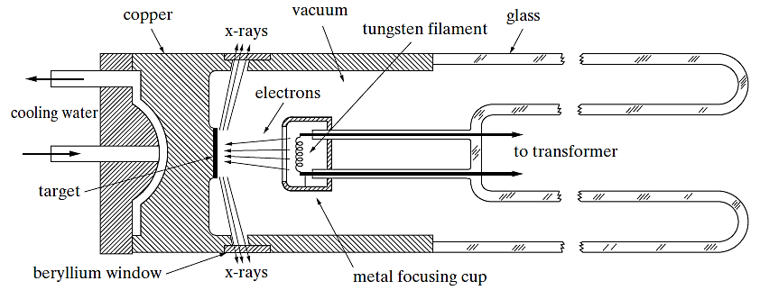
Production of X-rays: Filament Tube
Cross section of sealed x-ray tube (schematic)

Slide 8
All X-ray tubes contain two electrodes, an anode (the metal target) and a cathode. In filament tubes, an evacuated glass envelope which insulates the anode at one end from the cathode at the other, the cathode being a tungsten filament and the anode a water-cooled block of copper containing the desired target metal as a small insert at one end. One lead of the high-voltage transformer is connected to the filament and the other to ground, the target being grounded by its own cooling-water connection. The filament is heated by a filament current of about 3 amp and emits electrons which are rapidly drawn to the target by the high voltage across the tube. Surrounding the filament is a small metal cup maintained at the same high (negative) voltage as the filament: it therefore repels the electrons and tends to focus them into a narrow region of the target, called the focal spot. X-rays are emitted from the focal spot in all directions and escape from the tube through two or more windows in the tube housing. Since these windows must be vacuum tight and yet highly transparent to x-rays, they are usually made of beryllium.

Slide 9
The target is always water-cooled to prevent its heating since most of the kinetic energy of the electrons is converted into heat in the target, less than 1 percent being transformed into x-rays. The filament is heated by a filament current of ~3 amp and emits electrons which are rapidly drawn to the target by the high negative voltage between the cathode and anode. A small metal cup maintained at the same negative voltage as the filament repels the electrons and tends to focus them into a narrow region of the target. X-rays are emitted from the focal spot in all directions and escape from the tube through windows in the tube housing.

Slide 10
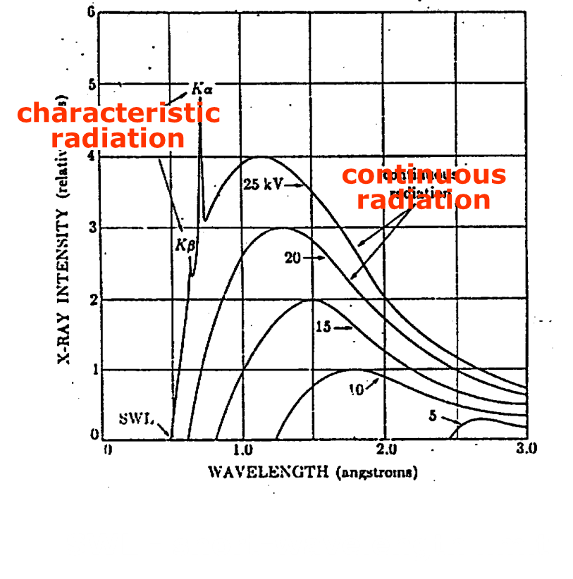
X-ray Spectrum
A spectrum of x-ray is produced as a result of the interaction between the incoming electrons and the inner shell electrons of the target element.
Two components of the spectrum can be identified, namely, the continuous spectrum and the characteristic spectrum.
SWL - short-wavelength limit

Slide 11
The Continuous x-ray Spectra
The electrons enter the target with kinetic energy equals to eV, where V is the accelerating voltage used. Fast moving e- will then be deflected or decelerated and EM radiation will be emitted.
The energy of the radiation depends on the severity of the deceleration, which is more or less random, and thus has a continuous distribution.
These radiation is called white radiation or bremsstrahlung (German word for ‘braking radiation’).

Slide 12
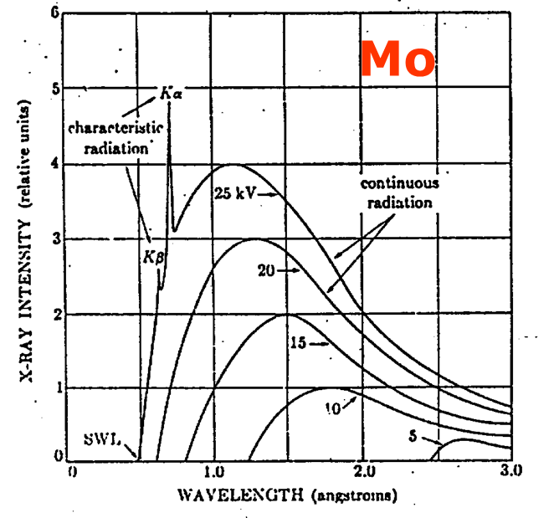
Characteristic x-ray Spectra
Sharp peaks in the spectrum can be seen if the accelerating voltage is high (e.g. 25 kV for molybdenum target).
These peaks fall into sets which are given the names, K, L, M…. lines with increasing wavelength

Slide 13
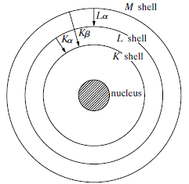
Characteristic x-ray Spectra
If an incoming electron has sufficient kinetic energy for knocking out an electron of the K shell (the inner-most shell), it may excite the atom to an high-energy state (K state).
One of the outer electron falls into the K-shell vacancy, emitting the excess energy as a x-ray photon.

Slide 14
Reference book
-elements of x-ray diffraction (B.D. Cullity)

Slide 15
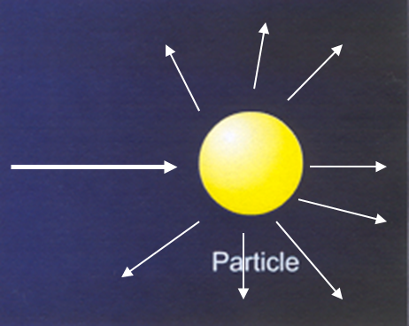
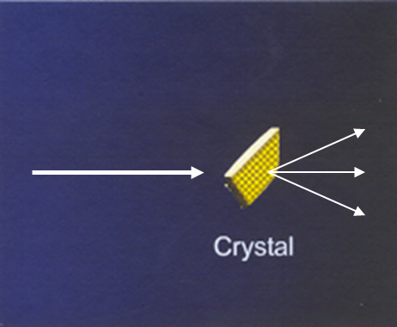
Diffraction
Diffraction occurs when a wave encounters a series of regularly spaced obstacles that are capable of scattering the wave and have spacings that are comparable in magnitude to the wavelength.
The particle scatters the incident beam uniformly in all directions.
The scattered beam may add together in a few directions and reinforce each other to give diffracted beams.

Slide 16
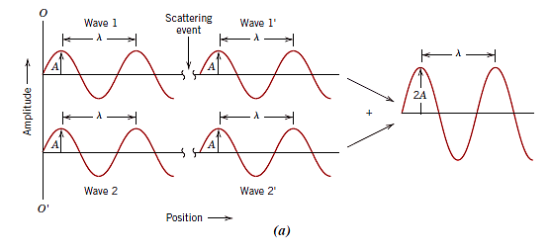
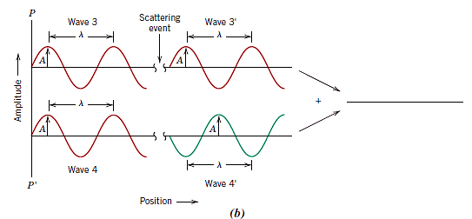
Constructive and Destructive Interference of Waves
(a) Demonstration of how two waves (labeled 1 and 2) that have the same wavelength λ and remain in phase after a scattering event (waves 1’ and 2’) constructively interfere with one another. The amplitudes of the scattered waves add together in the resultant wave. (b) Demonstration of how two waves (labeled 3 and 4) that have the same wavelength and become out of phase after a scattering event (waves 3’ and 4’) destructively interfere with one another. The amplitudes of the two scattered waves cancel one another.

Slide 17
X-ray Diffraction (XRD)

Slide 18
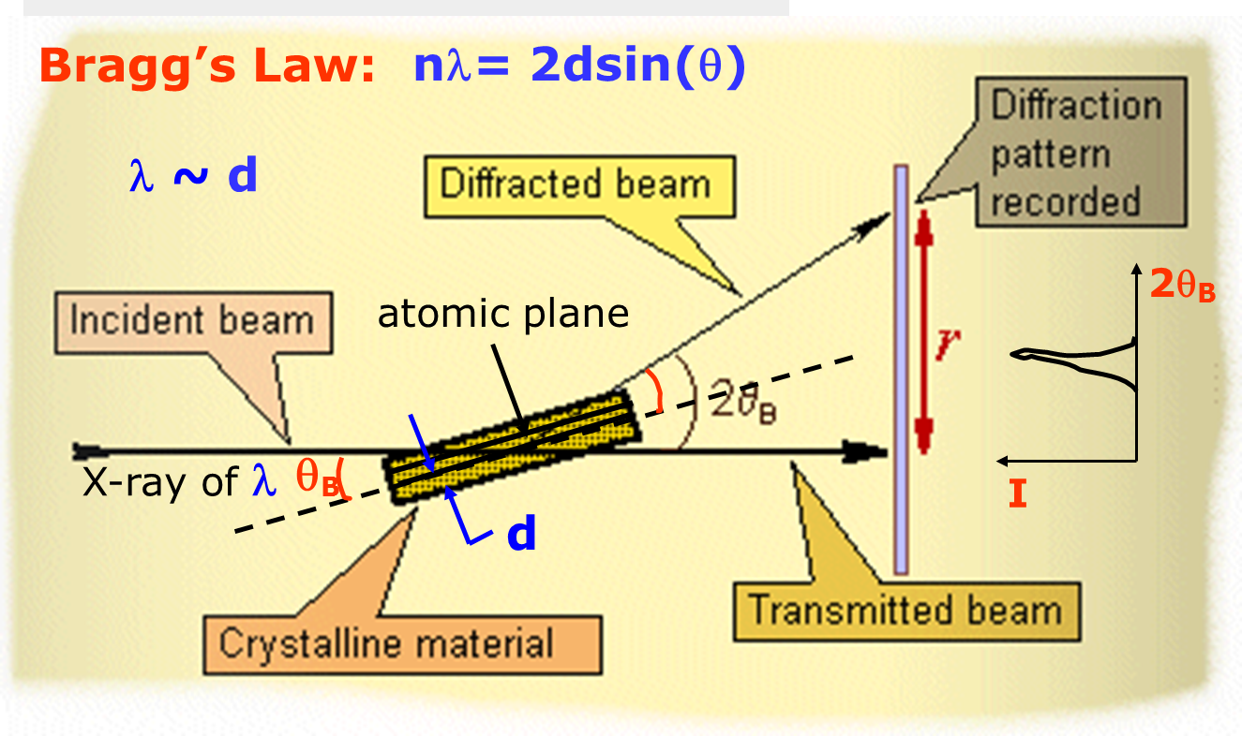
X-ray Diffraction
The atomic planes of a crystal cause an incident beam of x-rays (if wavelength is approximately the magnitude of the interatomic distance) to interfere with one another as they leave the crystal. The phenomenon is called x-ray diffraction.
In XRD, X-rays with λ~0.5-2Å, is incident on a specimen and is diffracted by crystalline phase in specimen according to Bragg’s Law. The intensity of the diffracted X-ray is measured as a function of the diffraction angle and the specimen orientation.
XRD patterns will provide a lot of information about materials structure and properties.

Slide 19
Bragg’s Law and X-ray Diffraction
The incident waves are reflected specularly from parallel planes of atoms in the crystal.
In specular (mirrorlike) reflection the angle of incidence is equal to the angle of reflection. The diffracted beams are found when the reflections from parallel planes of atoms interfere constructively.
The energy of the x-ray is not changed on reflection _elastic scattering.

Slide 20
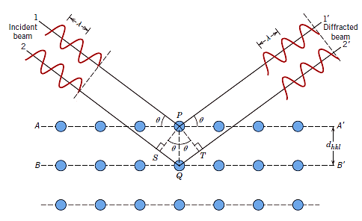
Bragg’s Law and X-ray Diffraction

Slide 21
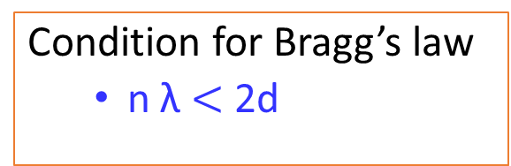
Bragg’s Law and X-ray Diffraction
nλ= SQ + TQ
SQ=TQ
n λ = 2SQ
sinθ=SQ/d
SQ=dsinθ
n λ =2dsinθ
Condition for Bragg’s law
n λ $<$ 2d
λ=2d_{hkl}sinθ_{hkl}
n – integer, called the order of diffraction
Diffraction occurs only when Bragg’s Law is satisfied
If Bragg’s law is not satisfied, then the interference will be nonconstructive so as to yield a very low-intensity diffracted beam.

Slide 22
Bragg’s Law and X-ray Diffraction
The Braggs were awarded the Nobel Prize in physics in 1915 for their work in determining crystal structures beginning with NaCl, ZnS, and diamond.
Limitations: It specifies when diffraction will occur for unit cells having atoms positioned only at cell corners. However, atoms situated at other sites (e.g., face and interior unit cell positions as with FCC and BCC) act as extra scattering centers, which can produce out-of-phase scattering at certain Bragg angles. The net result is the absence of some diffracted beams that should be present.

Slide 23
X-ray Diffraction Methods

Slide 24
XRD Methods- Determination of crystal structure
Three X-Ray Diffraction Method
Laue Method
Powder Method
Rotating Crystal Method

Slide 25
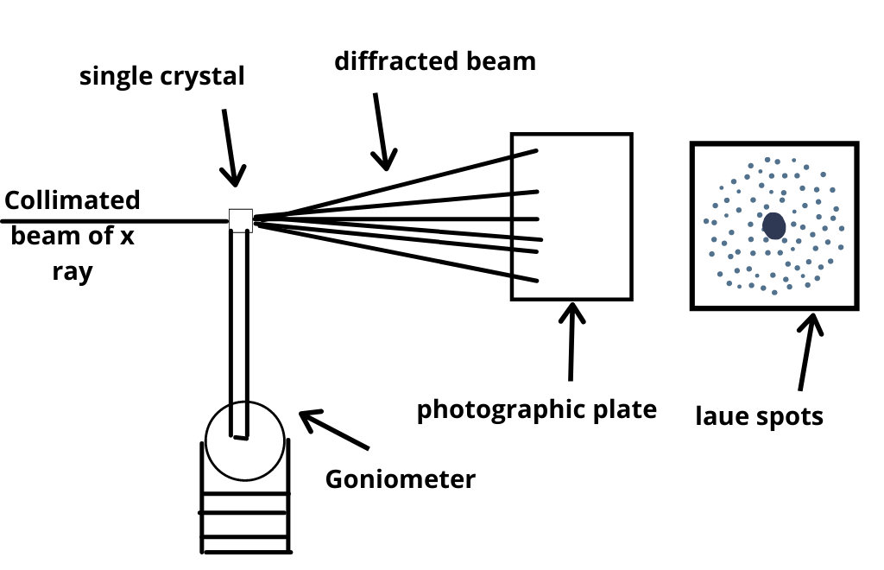
Laue Method
X-ray Source
Collimeter
Goniometer
Single Crystal
Photographic films

Slide 26
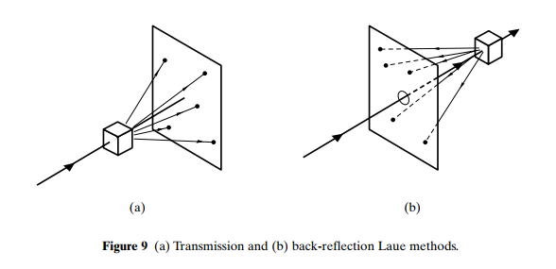
Laue Method

Slide 27
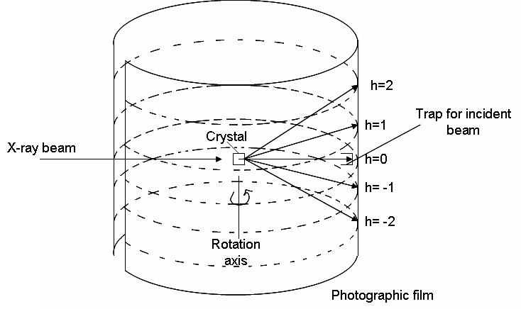
Rotating Crystal Method

Slide 28
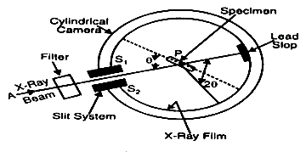
Powder Method

Slide 29
Summary of the XRD Methods
Methods | Source | Specimen | λ | θ
Laue | White X-ray | Single Crystal | Variable | Fixed
Powder | Monochromatic | Powder | Fixed | Variable
Rotating Crystal | Monochromatic | Single Crystal | Fixed | Variable (in part)

Slide 30
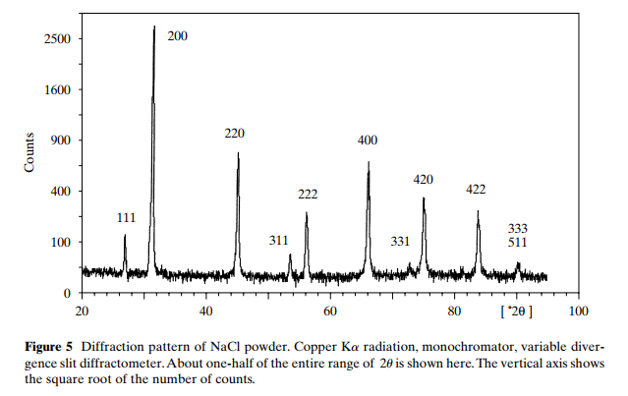
X-ray Diffraction Data

Slide 31
X-ray Diffraction Data
A diffractometer records changes of diffraction intensity with 2θ. The diffractometer records the diffraction intensity starting from a low 2θ and ending at a high 2θ. A number of intensity peaks located at different 2θ provide a ‘‘fingerprint’’ for a crystalline solid of each individual. Each peak represents diffraction from a certain crystallographic plane. Matching an obtained peak spectrum with a standard
spectrum enables us to identify the crystalline substances in a specimen. Spectrum matching is determined by the positions of the diffraction peak maxima and the relative peak intensities among diffraction peaks. In a modern diffractometer, data acquisition and treatment are mainly done by computer.

Slide 32
X-ray Diffraction Data
Crystal-Phase Identification-One of the most important uses of XRD
Obtain XRD pattern
Measure d-spacings
Obtain integrated intensities
Compare data with known standards in the JCPDS file, which are for random orientations (there are more than 50,000 JCPDS cards of inorganic materials).
Compare data with known standards in the ICSD data file

Slide 33
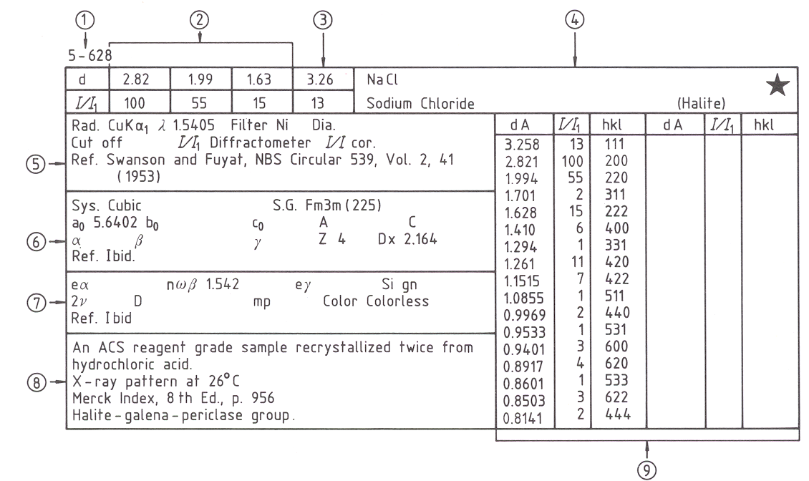
JCPDS Card
1.file number 2.three strongest lines 3.lowest-angle line 4.chemical formula and name 5.data on diffraction method used 6.crystallographic data 7.optical and other data 8.data on specimen 9.data on diffraction pattern.

Slide 34
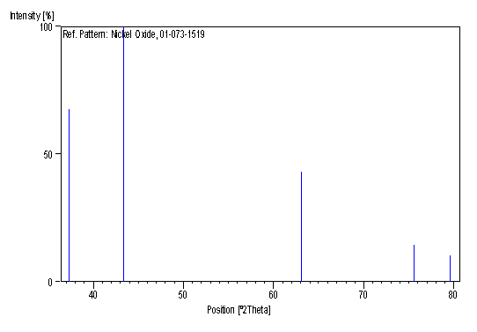
XRD pattern of NiO (Standard ICSD)
XRD pattern of NiO (experimental)

Slide 35
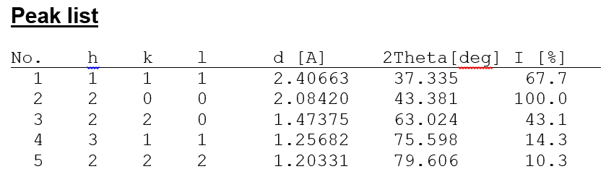
XRD pattern of NiO (Standard ICSD)
According to ICSD data
Reference code: 01-073-1519

Slide 36
X-ray Diffraction Data
Significance of Peak Shape in XRD
Peak position
Peak width
Peak intensity

Slide 37
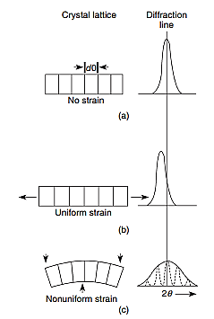
X-ray Diffraction Data
Peak Position
Effects of residual stress and strain on diffraction peak position and shape:
No strain;
Uniform strain;
Nonuniform strain.
The tensile stress of increasing the spacing shifts a peak to lower 2θ, while the compression stress of decreasing the spacing shifts a peak to higher 2θ in the spectrum.

Slide 38
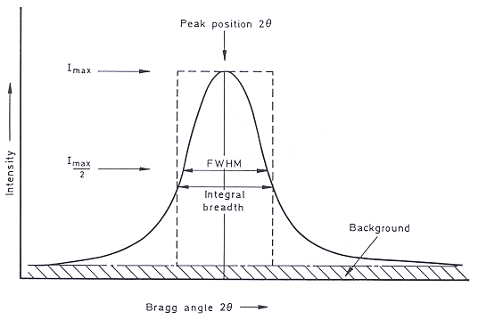
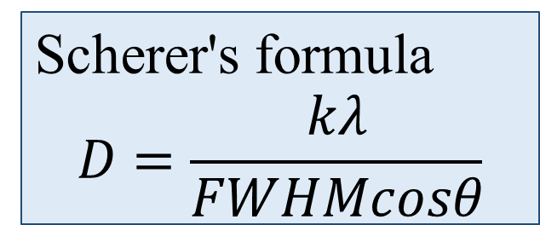
X-ray Diffraction Data
Peak Width-Full Width at Half Maximum (FWHM)
Crystallite Size
2. Residual strain
Scherer's formula
$$D=\frac{kλ}{FWHMcosθ}$$

Slide 39
X-ray Diffraction Data
Peak Intensity
Preferential Orientation

